Slide 1








Slide 2

Name: Anuja S. Raktate Email: anujaraktate2000@gmail.com Education: Msc(Mathematics)(2022)

Slide 3
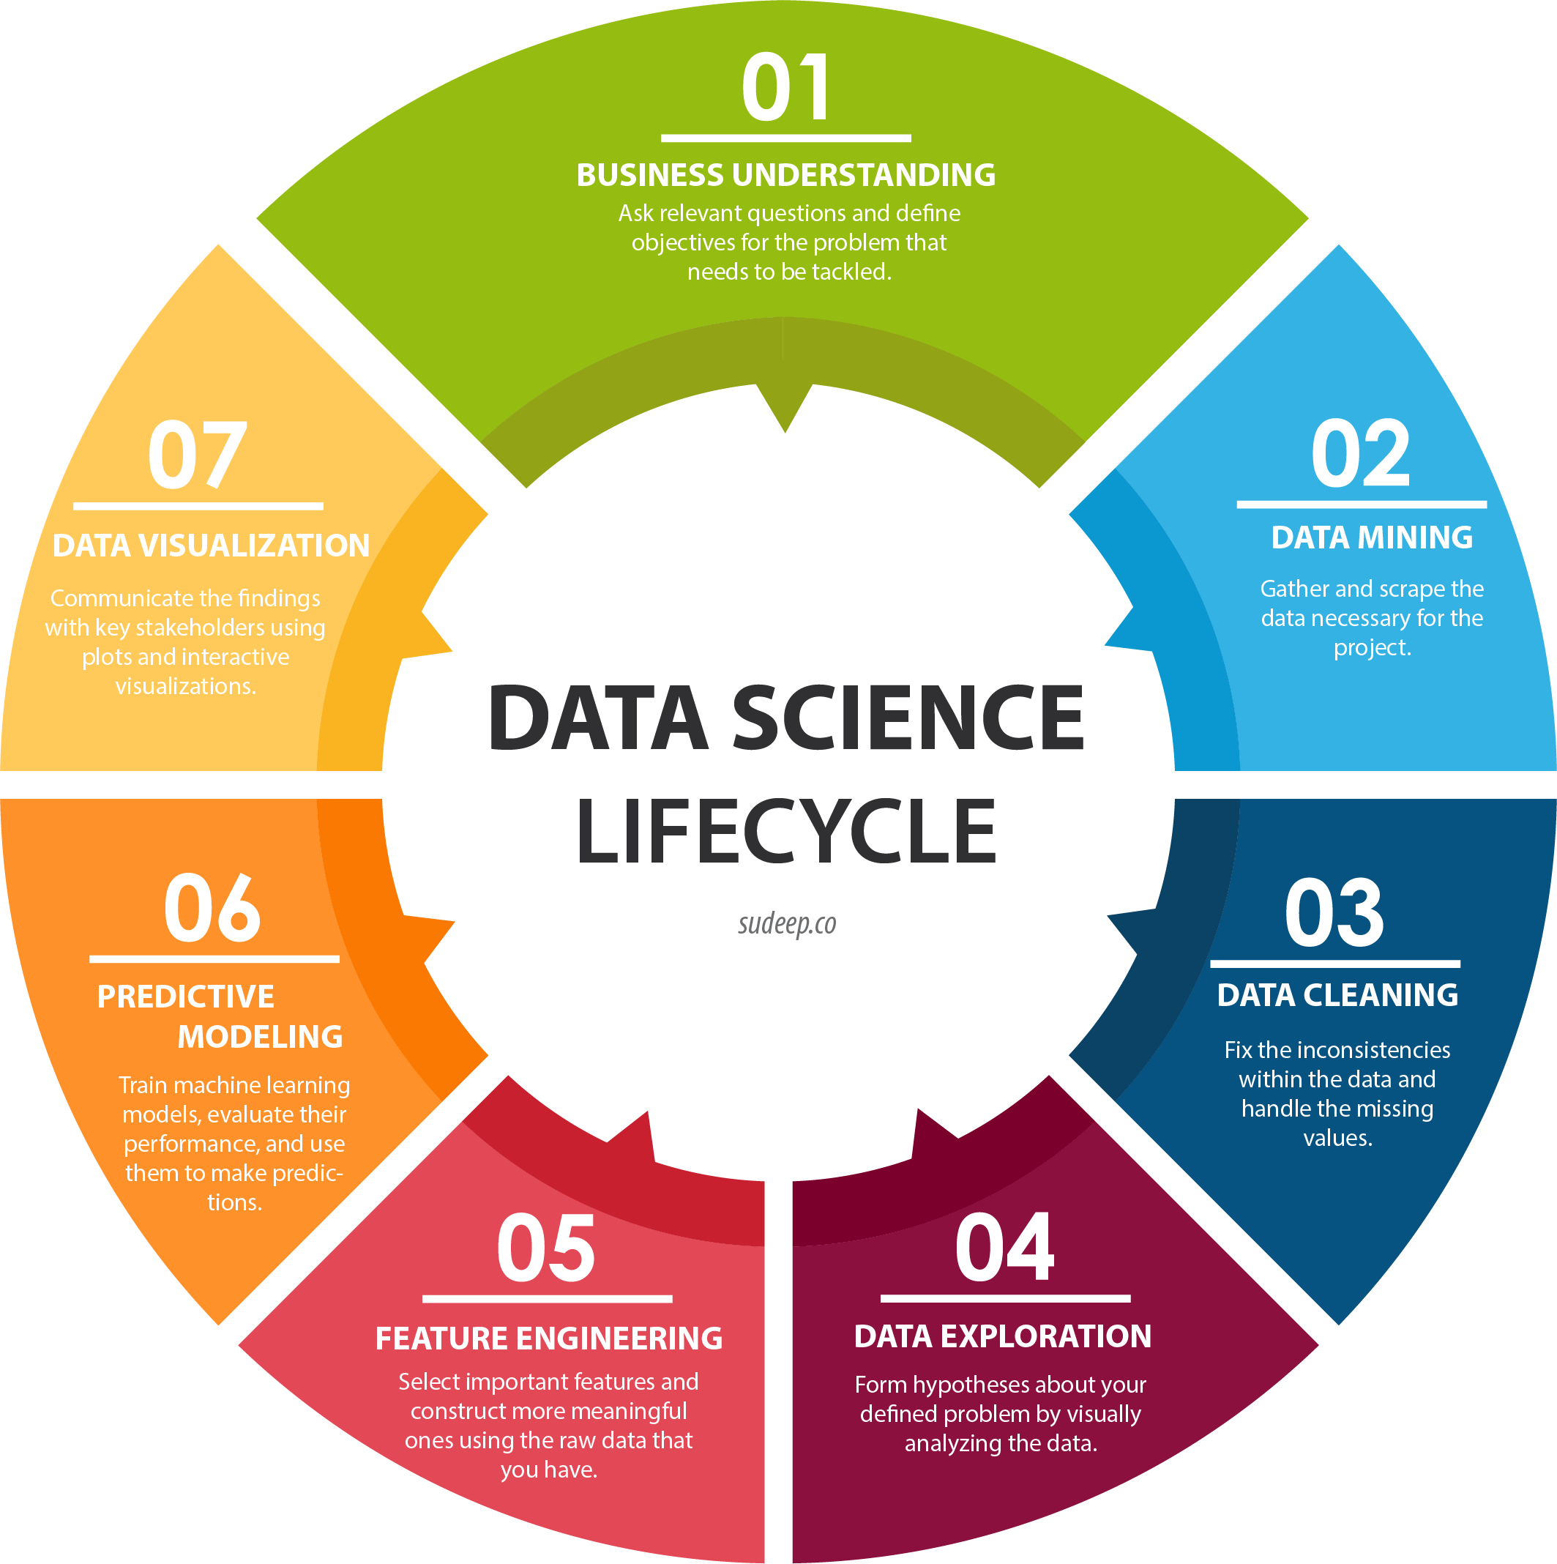
Web Scraping And EDA Project

Slide 4
Why we want to learn Data Science?
With Data Science, one can analyze massive graphical data, temporal data, and geospatial data to draw insights. It also helps in seismic interpretation and reservoir characterization.
Learning about data science provides an opportunity for you to recreate yourself
What is Web Scrapping?
Web scraping is an automatic method to obtain large amounts of data from websites. Most of this data is unstructured data in an HTML format which is then converted into structured data in a spreadsheet or a database so that it can be used in various applications.
Web Scrapping used for: 1. Price Monitoring 2. Market Research 3. News Monitoring

Slide 5
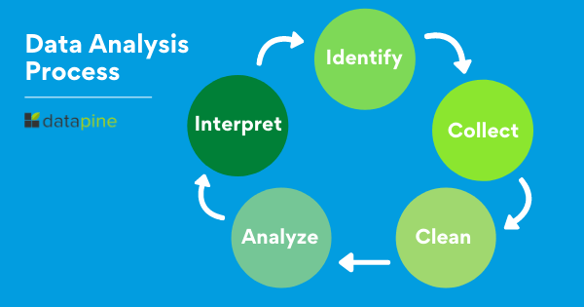
THE DATA ANALYSIS PROCESS

Slide 6
FIRST HAND / SECOND HAND CARS
SUB TITLE :-
URL
Problem Statement
Extract the Data
Data Frame
Export into .csv format
Read CSV File
Clean the Data
Data Analysis and Visualization (EDA)
1) Uni-variate Analysis
2) Bi-Variate Analysis/Multivariate
Conclusion

Slide 7

DATA COLLECTION
“What is data?” The abridged answer is, data is various kinds of information formatted in a particular way. Therefore, data collection is the process of gathering, measuring, and analyzing accurate data from a variety of relevant sources to find answers to research problems, answer questions, evaluate outcomes, and forecast trends and probabilities
Data collection is the process of gathering and measuring information on targeted variables in an established system, which then enables one to answer relevant questions and evaluate outcomes. Data collection is a research component in all study fields, including physical and social sciences.

Slide 8
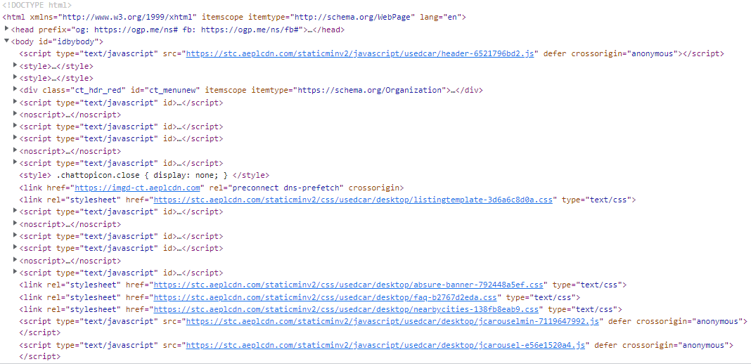
URL=https://www.cartrade.com/buy-used-cars/?gcc=1#city=10&sc=-1&so=-1&pn=1

Slide 9

Problem Statement:-
1) Analayzing Selling Price of used Cars.
2) Comparison Of Cost Of Cars Vs EMI Of Car Price.
3) Analayzing Average Car Prize For Data Benchmarking.
4) Extra Features Of Car That Improve Scalability.
5) Specific Models Of Cars In High Demand.

Slide 10
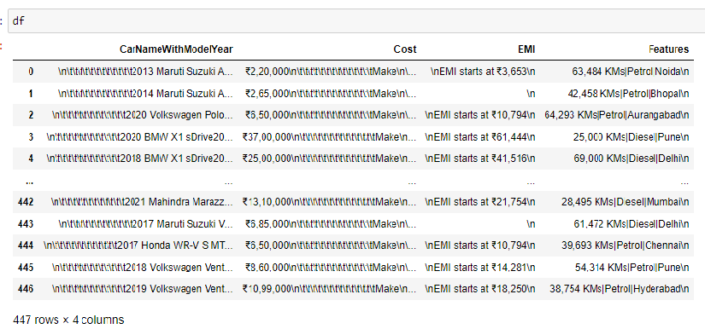
Scraped the Raw Data

Slide 11
Data Cleaning
Data cleaning is the process of fixing or removing incorrect, corrupted, incorrectly formatted, duplicate, or incomplete data within a dataset.
When combining multiple data sources, there are many opportunities for data to be duplicated or mislabeled

Slide 12
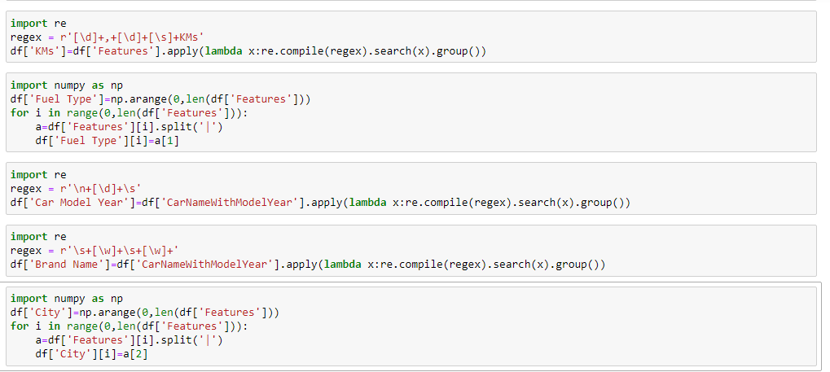
Steps involved in the process of cleaning the Data 1) Remove all special characters
2)Extracting required words from the data

Slide 13



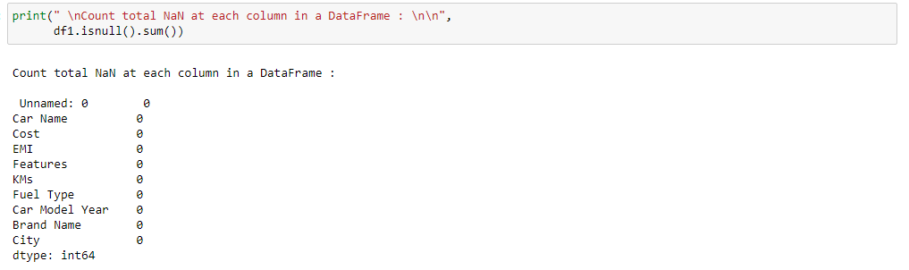
3) Cleaning / Filling Missing Data Replace Nan with a Scalar Value
4) Drop Duplicate Values
5) Check for Missing Values

Slide 14
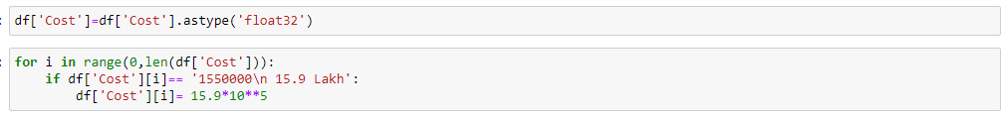
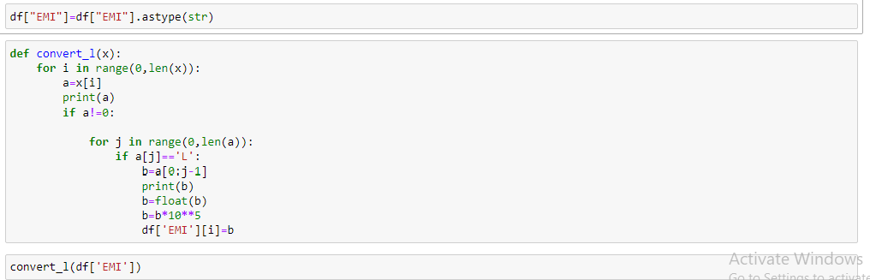


6)Converting Datatypes into Required Types

Slide 15
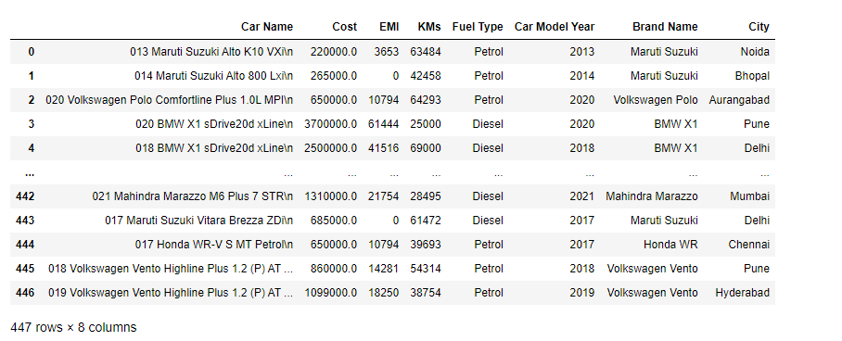
Final Data(Cleaned Data)

Slide 16
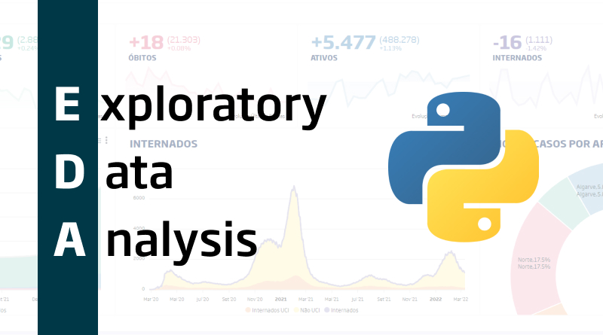
EDA is applied to investigate the data and summarize the key insights.
Statistics, exploratory data analysis (EDA) is an approach of analyzing data sets to summarize their main characteristics, often using statistical graphics and other data visualization methods.
The primary goal of EDA is to maximize the analyst's insight into a data set and into the underlying structure of a data set, while providing all of the specific items that an analyst would want to extract from a data set, such as: a good-fitting, parsimonious model.

Slide 17
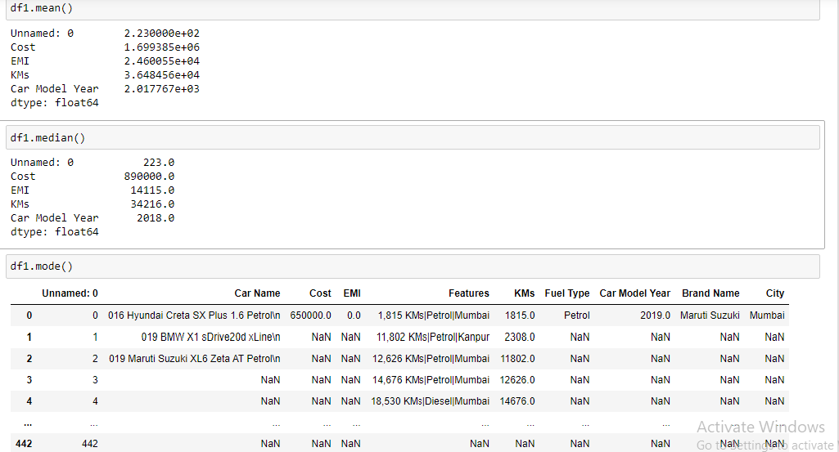
Univariate
Analysis
Continuous
variable
Central Tendency
Mean
Median
Mode

Slide 18
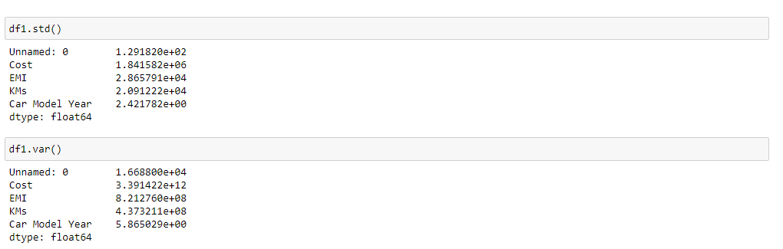
Measures of Dispersion
Standard Deviation
Variance

Slide 19
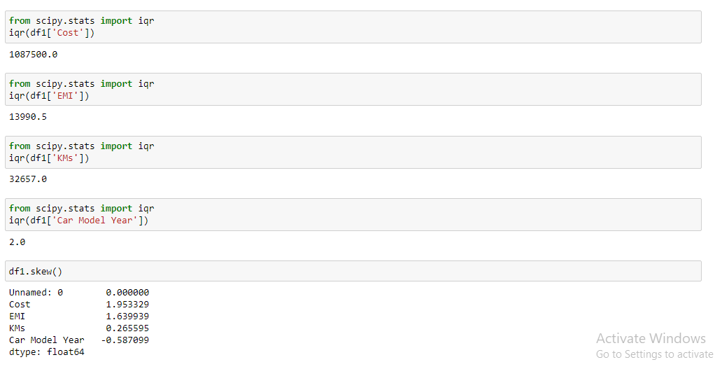
Inter-Quartile Range
Skewness

Slide 20
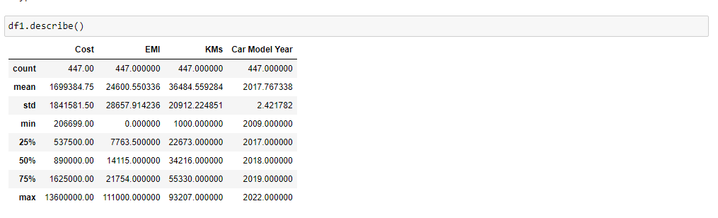
Describe()

Slide 21
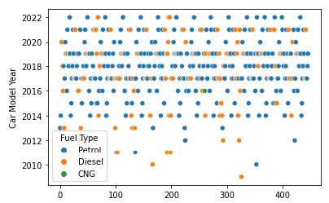
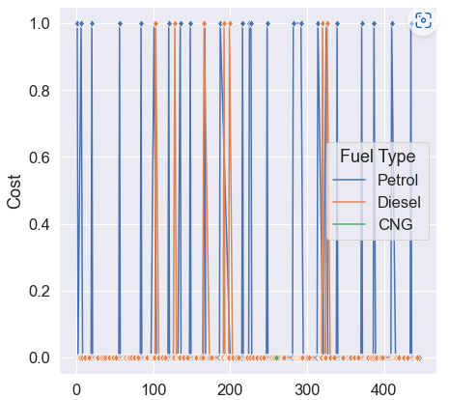
SCATTER PLOT :
.
In our plot here the blue colors dot show the number of Petrol cars, the orange colour shows number of Disel cars and the green colour shows number of CNG cars used from this we can observe that in our data in year 2010-2023 there is large amount of Petrol cars were used than Disel cars and very few amount of CNG cars are there.
LINE PLOT (with markers) :
The Line Plot of 'Cost' it has two important factor cost and Index and here from the plot based on our dataset we observe that there are maximum numbers of petrol cars are present which having cost<400000 and there are very few numbers of Disel cars are present which having cost<400000 i.e Cost of most of the disel cars is >400000 . and there is no any CNG Cars which satisfies our condition i.e cost of cars<400000 , that means There is no any CNG cars present under the cost 4lakh.that's the informataion of Cost of cars by using its Fuel type shown here.

Slide 22
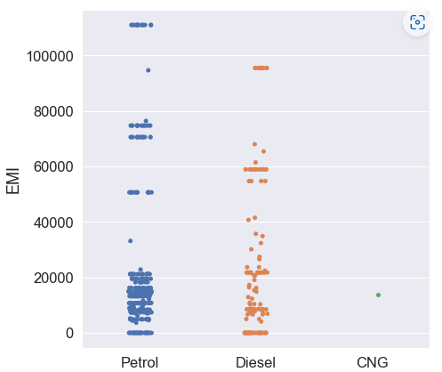
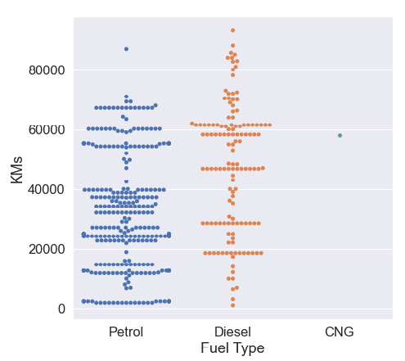
STRIP PLOT :
so, basically EMI is mostly comes to range between 0 to 20000. And here the petrol & Disel are both the fuel types but mostly the cars having fuel type as petrol are used most and has EMI is also at minimum range of 0-20000 as compare to Petrol Cars, Disel cars having also EMI at range 0-20000 but the use of disel cars is less than petrol. and there is very less amount of CNG cars present in our data set having EMI between the same range. and the cars of EMI cost at Rs.40000 & above there is minumum amount cars present having fuel type petrol and disel.
SWARM PLOT :
so, basically KMs is mostly comes to range between 0 to 70000. And here the Petrol & Disel are both the Fuel Types Cars used frequently but mostly the cars having Fuel Type as Petrol are used most.
As compare to petrol Cars, Disel cars having also KMs at range 0-70000 but the use of disel cars is less than petrol. and there is very less amount of CNG cars present in our data set having KMs range is 60000 aprox.
And the cars having KMs70000 & above there is very few amount cars present having fuel type petrol and disel.

Slide 23
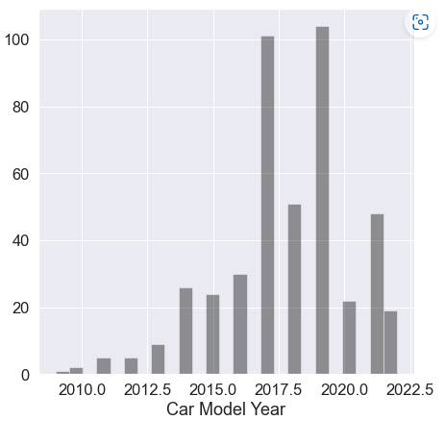
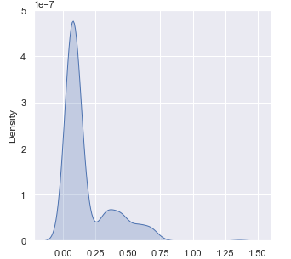
HISTOGRAMS :
So The most of the car's having model year in between 2017-2020 and it's percentage is very high like 80% & above. and Car's of model Year 2010-2016 is present at minimum Percentage structure of car model year.
Also The car's of model year between 2010-2013 is present in very less amount in our d ataset and 2017-2019 is the very high percentage of the car model year. But 2019 is the very high car model year in percentage wise as compare all of this year.
DENSITY PLOT :
Here cost of some cars is very high which is shown in graph as density of cost i.e it is grater than 4 as density wise. and also the cost of 0.50% cars i.e between 0-1 that having cost in between 0.25 to 0.75. and cost of remaning cars present in our dataset is very low as compare to others.

Slide 24
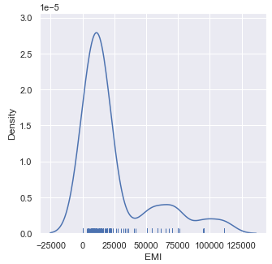
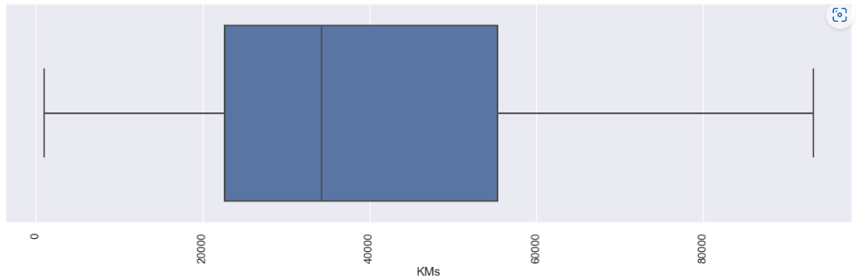
RUG PLOTS :
Here The density of cars which having minumum amount of EMI upto Rs.25000 is very high which is between 2.5-3.0 of the density as shown in graph. and their are very few cars like density in between 0.0-0.5 which has very high amount of EMI cost between Rs.40000-Rs.140000 are shown here.
BOX PLOTS :
This graph shows us the range of KMs of cars .The Cars having KMs between the range 20000-40000 is maximum than the cars having KMs between range 40000-60000.

Slide 25
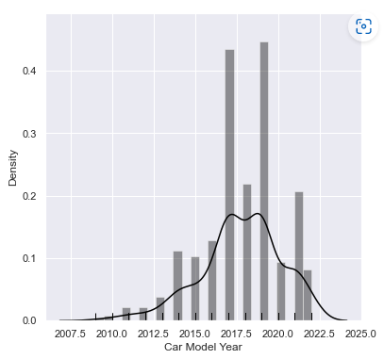
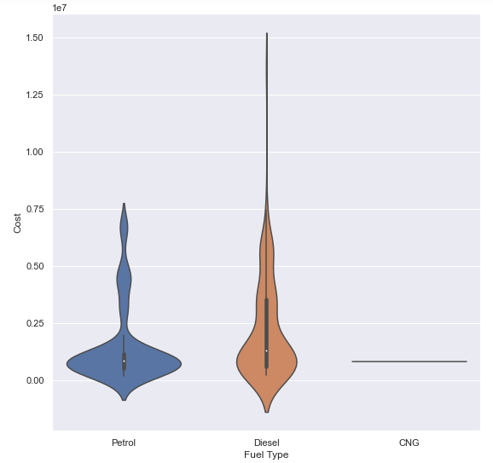
distplot() :
This plot is Car Model year and their Density of Car's which present in given Year's .So The most of the car's of model year present in year 2017-2021 and it's density is very high i.e 0.4 & above. and Car's of model Year 2010-2015 is present at minimum density structure of car model year.
Also car's of model year 2010-2012 is present in very less amount and basically 2017-19 is the very high percentage of the car model year. But 2019 is the very high car model year in percentage wise as compare all of this year.
VIOLIN PLOTS :
The Violin Plot of 'Cost' of Cars considering its Fuel Type like Petrol, Disel, CNG and here from the plot based on our dataset we observe that on the above of 0.75 of cost there are very few vheical range it is near about 1% only but under 0.75 of cost there is maximum range of Cost of vehical. Also it shows in the range of 0.00 to 0.25 of cost there is very maximum range area of cost of vehical depends on Fuel Type and that's the informataion of Cost of cars by using its Fuel type shown here.

Slide 26
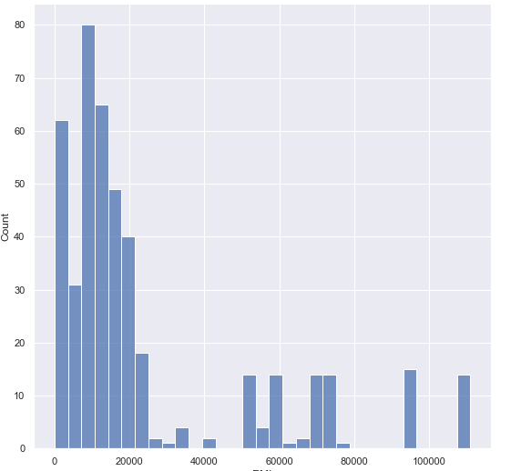
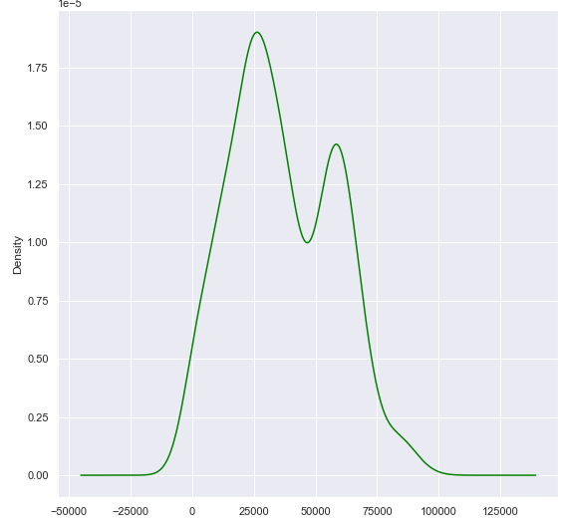
Histogram:
Here The count of cars which has minimum amount of EMI cost between the range 0-25000 is very high which is approx to 80% of the total count .and their are very few cars which has very high amount of EMI cost between Rs.50000-Rs.12500 are shown here which has count between range 0-15 aprox.
Density Plot:
The Cars having KMs between the range 20000-40000 is maximum. i.e its density is grater than 1.75 and the cars having KMs between range 40000-60000 have density in between 1.00-1.50.are observed from this graph.

Slide 27
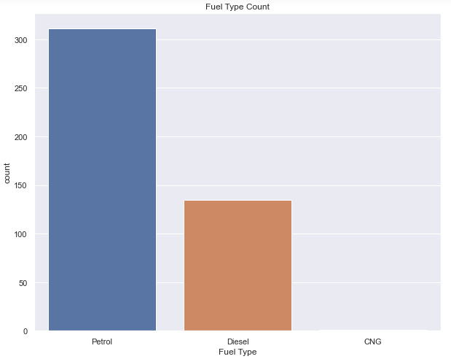
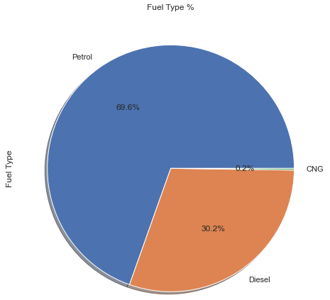
BAR CHART:
Here In our dataset the count of Petrol cars is maximum i.e above 300 of the count of total cars present in our dataset. their are minumum count of Disel cars which is aprox 130 only. and their are very less amount of CNG Cars present in our datset. CNG cars are very rare in our data set.
PIE CHART :
Also From by this pie diagrame we can observe that their are 69.6% of Petrol Cars, 30.2% of Disel Cars And 0.2% of CNG Cars present in our data set.

Slide 28
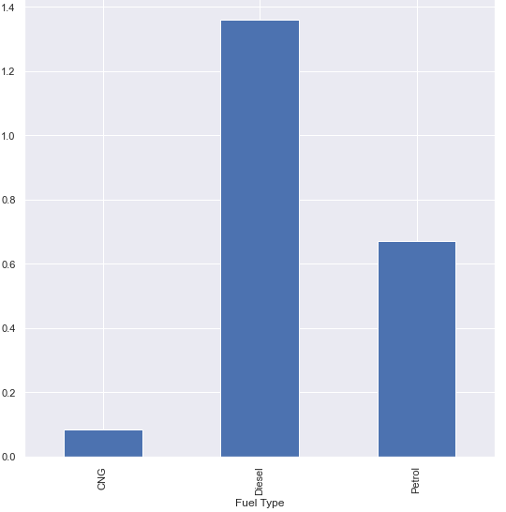
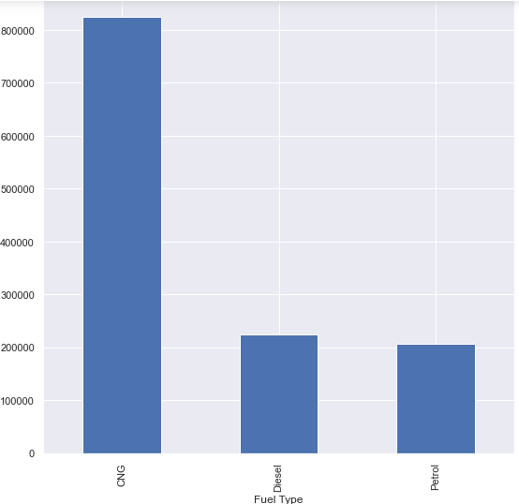
Groupby function for Fuel Type and its Cost for Maximum.
Bivariate/ Multivariate Analysis :
groupby():
Groupby function for Fuel Type and its Cost for Minimum.

Slide 29
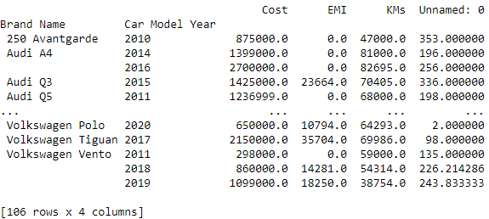
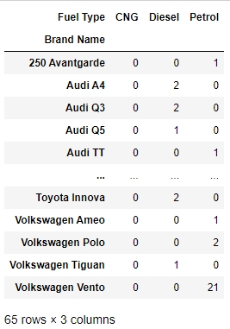
Pivot Table:
Crosstab:
Here we can use the crosstab plot for all Cars Brand and considering its Fuel type like Petrol, Disel, CNG present in our dataset.
From this pivot table we get the information about First Hand/ Second Hand cars present in our dataset with its different features like its Brand Name, Car Model Year, Cost of car , EMI , and its KMs.

Slide 30
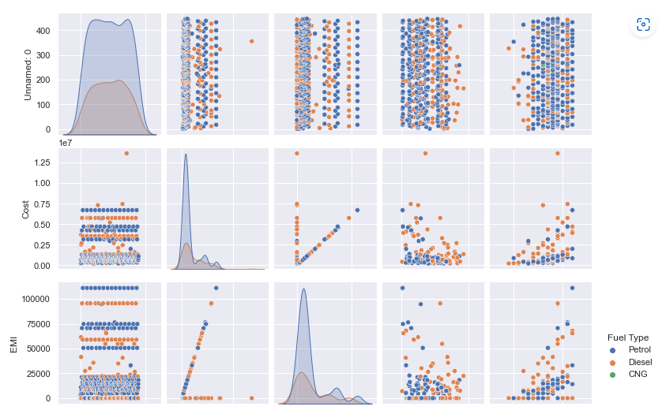
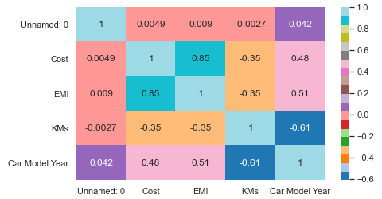
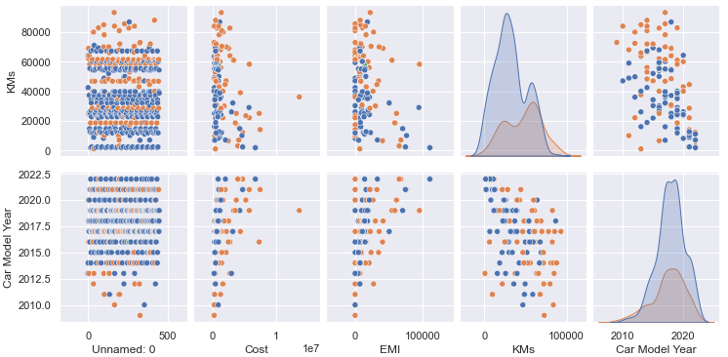
Pairplot:
Heatmap:
Heat Maps is to better visualize the volume of different Features of Cars within a dataset and assist in directing viewers towards areas on data visualizations that matter most.

Slide 31
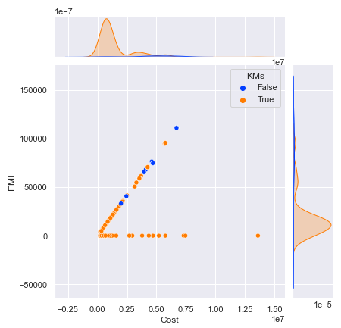
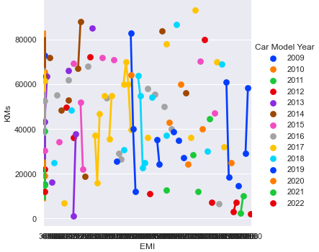
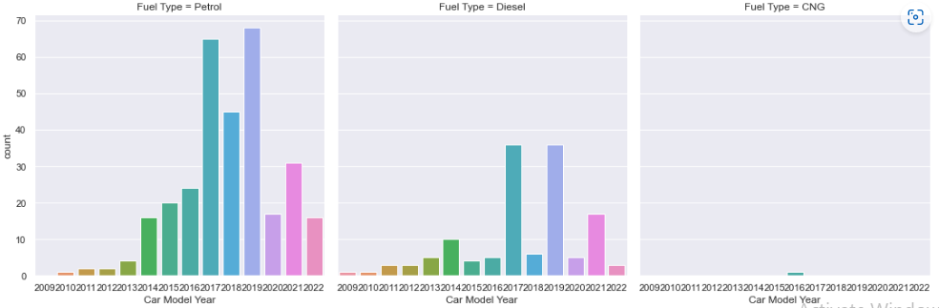
Jointplot:
Point plot:
Count Plot:

Slide 32
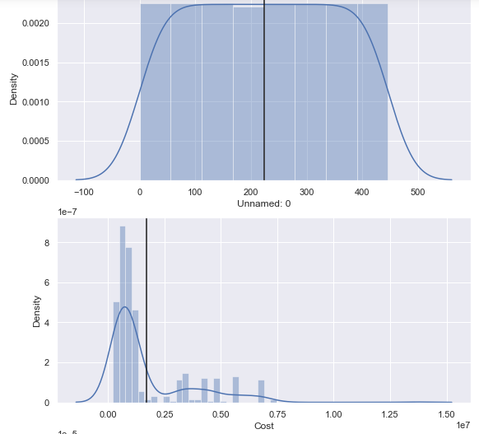
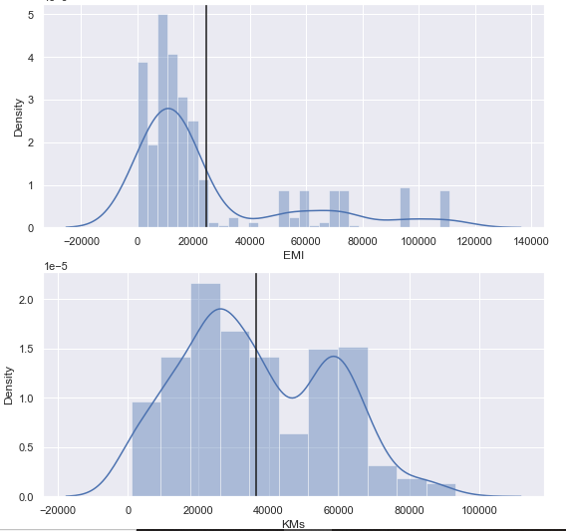
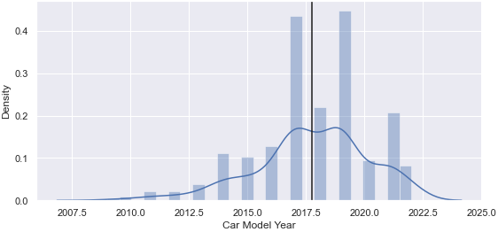
Distribution Plot:

Slide 33
Conclusion:-
The data that we are going to use in this example is about First Hand/ Second Hand Cars. Specifically containing various information data points about the used cars, like their Car Name, Cost, EMI, Features, KMs, Fuel Type, Car Model Year, Brand Name, City etc.
By this analysis we can observe that in our data in year 2010-2023 there is large amount of Petrol cars were used than Disel cars and very few amount of CNG cars are there.
Also There are most of the car's having model year in between 2017-2020. And the count of the Cars having minumum amount of EMI upto Rs.25000 is very high .
Also From by the pie diagram we can conclude that their are 69.6% of Petrol Cars, 30.2% of Disel Cars And 0.2% of CNG Cars present in our data set. i.e. By considering the fuel type of cars the count of petrol cars is high , than Disel and CNG Cars.

Slide 34

THANK YOU

